Slide 1
PSSAR / GSG ADVANCED TRAINING
ML-Based Thermal
Risk Prediction
Multi-sensor incubator system · 5, 10 and 15 minute horizons
FINAL SYSTEM
3 models + API
Chronological evaluation
and deployment-ready pipelines
Fady Alami
Final capstone presentation
Notes:
Introduce the project as an early-warning classifier for future thermal risk. Emphasize that the output is predictive decision support, not an automatic controller.
[Sources]
- final_analysis_bundle.zip: final_analysis/final_analysis_report.md

Slide 2
CAPSTONE PROJECT
02
What the project needed to achieve
PROBLEM
DELIVERABLE
Predict risk before it happens
A reproducible ML service
• Combine four temperature sensors and controller state
• Predict LOW / NORMAL / HIGH at 5, 10 and 15 minutes
• Preserve time order and prevent target leakage
• Validated preparation and feature pipeline
• Compared three classifier families
• Saved complete inference pipelines
• Exposed /health and /predict with FastAPI
ML-Based Thermal Risk Prediction
Notes:
The scope was deliberately limited to reliable classification and deployment. Closed-loop or disturbance-aware control was not implemented and remains future work.
[Sources]
- final_analysis_bundle.zip: final_analysis/final_analysis_report.md

Slide 3
CAPSTONE PROJECT
03
Five milestones from raw logs to API
Each stage produced a checked artifact before the next stage began.
01
02
03
04
05
Validate
Prepare
Engineer
Model
Deploy
Schema, timestamps, numeric ranges
Sequence-aware cleaning and metadata
31 current and historical features
Chronological split and comparison
Three pipelines and FastAPI
ML-Based Thermal Risk Prediction
Notes:
Walk through the five-stage structure. The sequence matters: data and leakage checks were completed before model selection or deployment.
[Sources]
- final_analysis_bundle.zip: final_analysis/source_inventory.csv
- final_analysis_bundle.zip: final_analysis/final_analysis_report.md

Slide 4
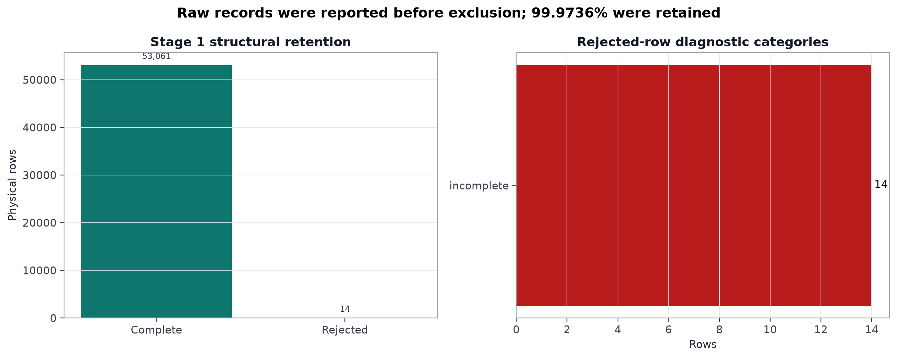
DATA EVIDENCE
04
Stage 1 — validation retained almost all rows
RAW
53,075 rows
Input logs inspected
RETAINED
99.9736%
53,061 complete rows
REJECTED
14 rows
Explicitly recorded
ML-Based Thermal Risk Prediction
Notes:
The rejection rate was very small, but rejected rows were still reported rather than silently removed.
[Sources]
- final_analysis_bundle.zip: final_analysis/plots/01_stage1_data_retention.png
- final_analysis_bundle.zip: final_analysis/stage1_validation_summary.csv

Slide 5
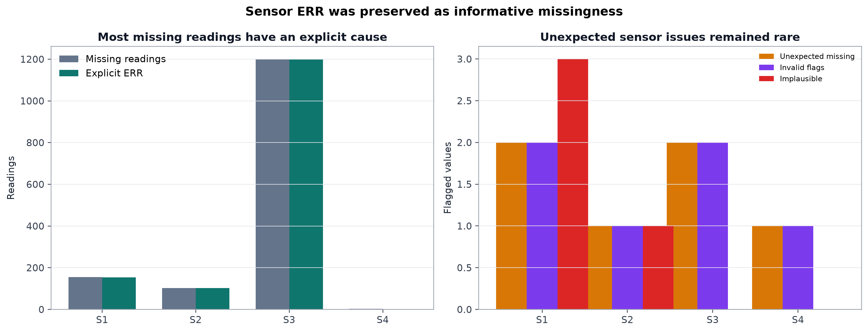
DATA EVIDENCE
05
Stage 2 — sensor issues were observable, not random
STRUCTURE
9 sequences
Handled as separate runs
SAMPLING
16.349 s
Median time interval
QUALITY
99.59%
Missing values explained by ERR status
ML-Based Thermal Risk Prediction
Notes:
The sensor status flags explain almost all missing readings: 1,456 of 1,462 missing values. Heater_on was excluded because its logging resolution was unreliable.
[Sources]
- final_analysis_bundle.zip: final_analysis/plots/02_sensor_quality_evidence.png
- final_analysis_bundle.zip: final_analysis/sensor_missingness_evidence.csv

Slide 6
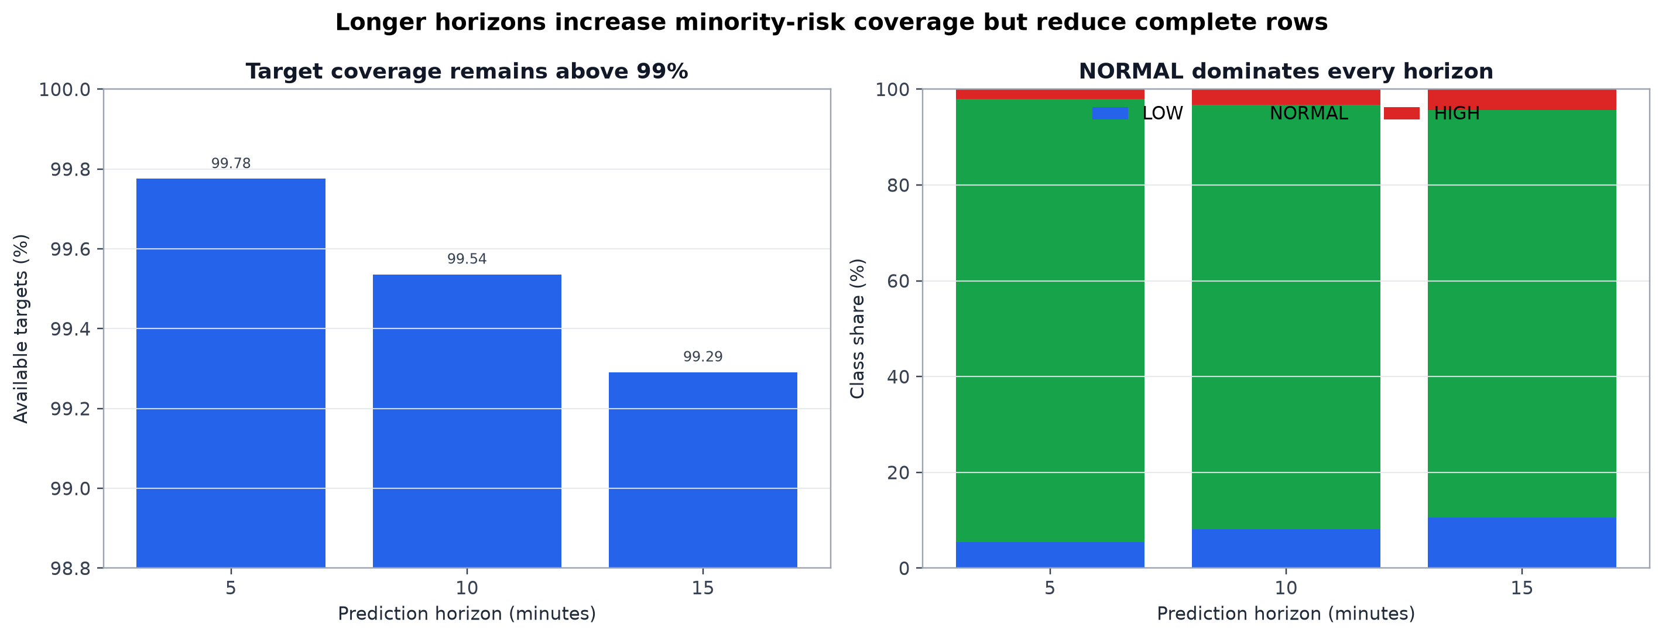
FEATURE & TARGET DESIGN
06
Stage 3 — future labels were built without leakage
HORIZONS
5 / 10 / 15 min
Three independent targets
BANDS
Mode-aware
NRML 37.3–37.7°C
HTCH 37.1–37.5°C
LEAKAGE
Future = label only
Predictors use present and past
ML-Based Thermal Risk Prediction
Notes:
Targets use future temperatures; features do not. Thirteen, 118 and 290 ambiguous rows were excluded at the 5, 10 and 15 minute horizons respectively.
[Sources]
- final_analysis_bundle.zip: final_analysis/plots/04_target_availability_and_class_balance.png
- final_analysis_bundle.zip: final_analysis/leakage_reproducibility_audit.csv

Slide 7
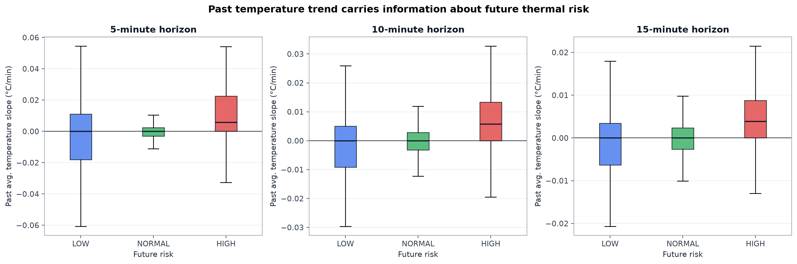
ASSUMPTION EVIDENCE
07
Slope features captured thermal direction
ASSUMPTION
Direction matters
Fast rises/falls signal changing risk
EVIDENCE
Classes separate
Slope distributions shift by future class
DESIGN
Multiple windows
5, 10 and 15 minute history
ML-Based Thermal Risk Prediction
Notes:
This plot supports the decision to include large positive and negative slopes in engineered features and in API stress tests.
[Sources]
- final_analysis_bundle.zip: final_analysis/plots/06_slope_by_future_risk.png
- final_analysis_bundle.zip: final_analysis/slope_risk_summary.csv

Slide 8
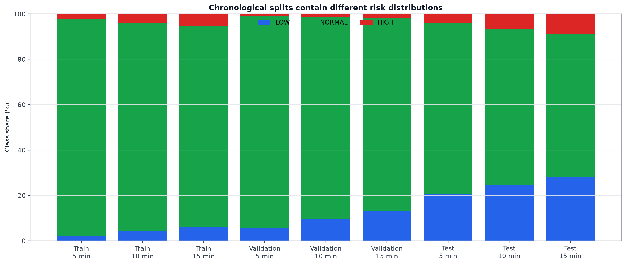
MODELING DESIGN
08
Stage 4 — evaluation followed time and sequence
TRAIN
28,264 rows
Sequences 1, 2, 3, 5
VALIDATE
19,759 rows
Sequence 7
TEST
4,307 rows
Sequences 8 and 9 · no shuffle
ML-Based Thermal Risk Prediction
Notes:
The split is intentionally harder than a random split because it measures transfer to later unseen sequences. Distribution shift is therefore visible and reported.
[Sources]
- final_analysis_bundle.zip: final_analysis/plots/08_split_class_distribution.png
- final_analysis_bundle.zip: final_analysis/key_metrics.csv

Slide 9
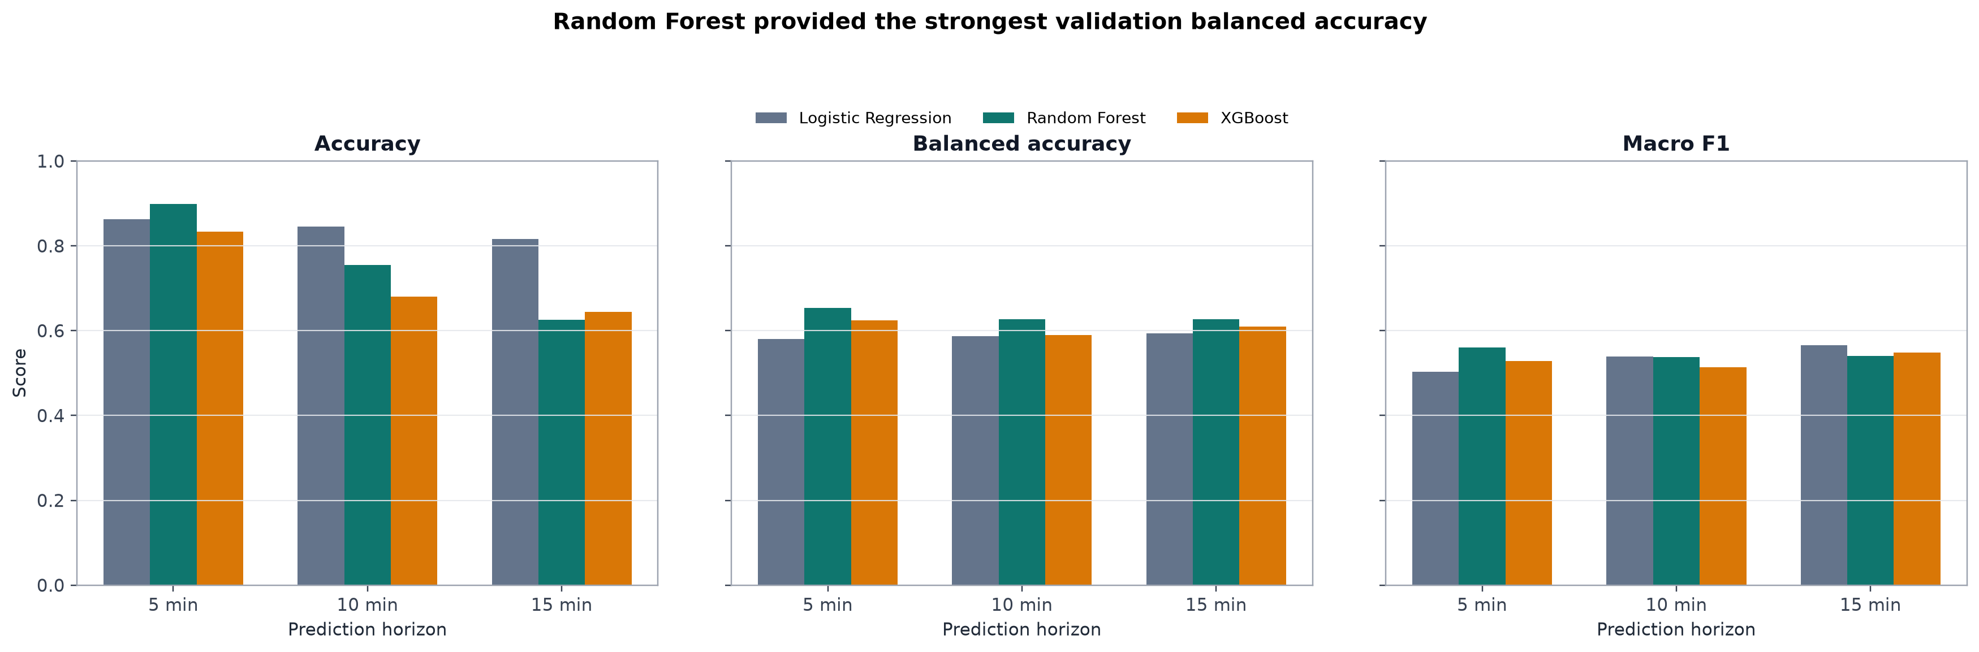
MODEL SELECTION
09
Random Forest was selected on balanced accuracy
5 MIN
0.653 BA
Random Forest validation
10 MIN
0.628 BA
Random Forest validation
15 MIN
0.627 BA
Random Forest validation
ML-Based Thermal Risk Prediction
Notes:
Logistic Regression, Random Forest and XGBoost were compared. Balanced accuracy was the selection metric because NORMAL dominates the classes.
[Sources]
- final_analysis_bundle.zip: final_analysis/plots/10_validation_model_comparison.png
- final_analysis_bundle.zip: final_analysis/key_metrics.csv

Slide 10
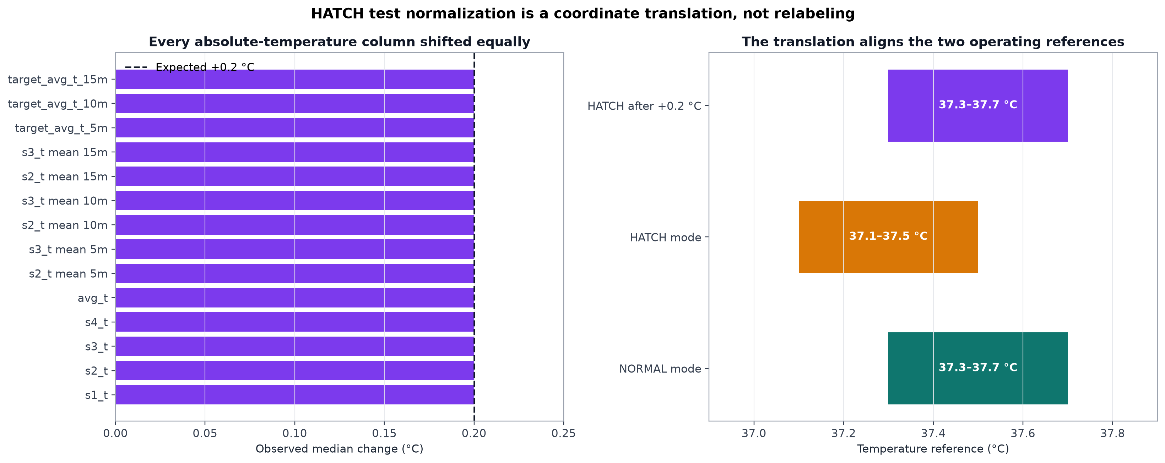
TEST PROTOCOL
10
HATCH normalization was explicit and limited
SHIFT
+0.2°C
HATCH-only absolute temperatures
UNCHANGED
Labels & slopes
Also spread, mode and controller fields
PURPOSE
Comparable scale
Fixed held-out evaluation
ML-Based Thermal Risk Prediction
Notes:
Normalization was not allowed to change labels or dynamic features. The verification table records which columns changed and which stayed fixed.
[Sources]
- final_analysis_bundle.zip: final_analysis/plots/09_hatch_normalization_verification.png
- final_analysis_bundle.zip: final_analysis/normalization_verification.csv

Slide 11
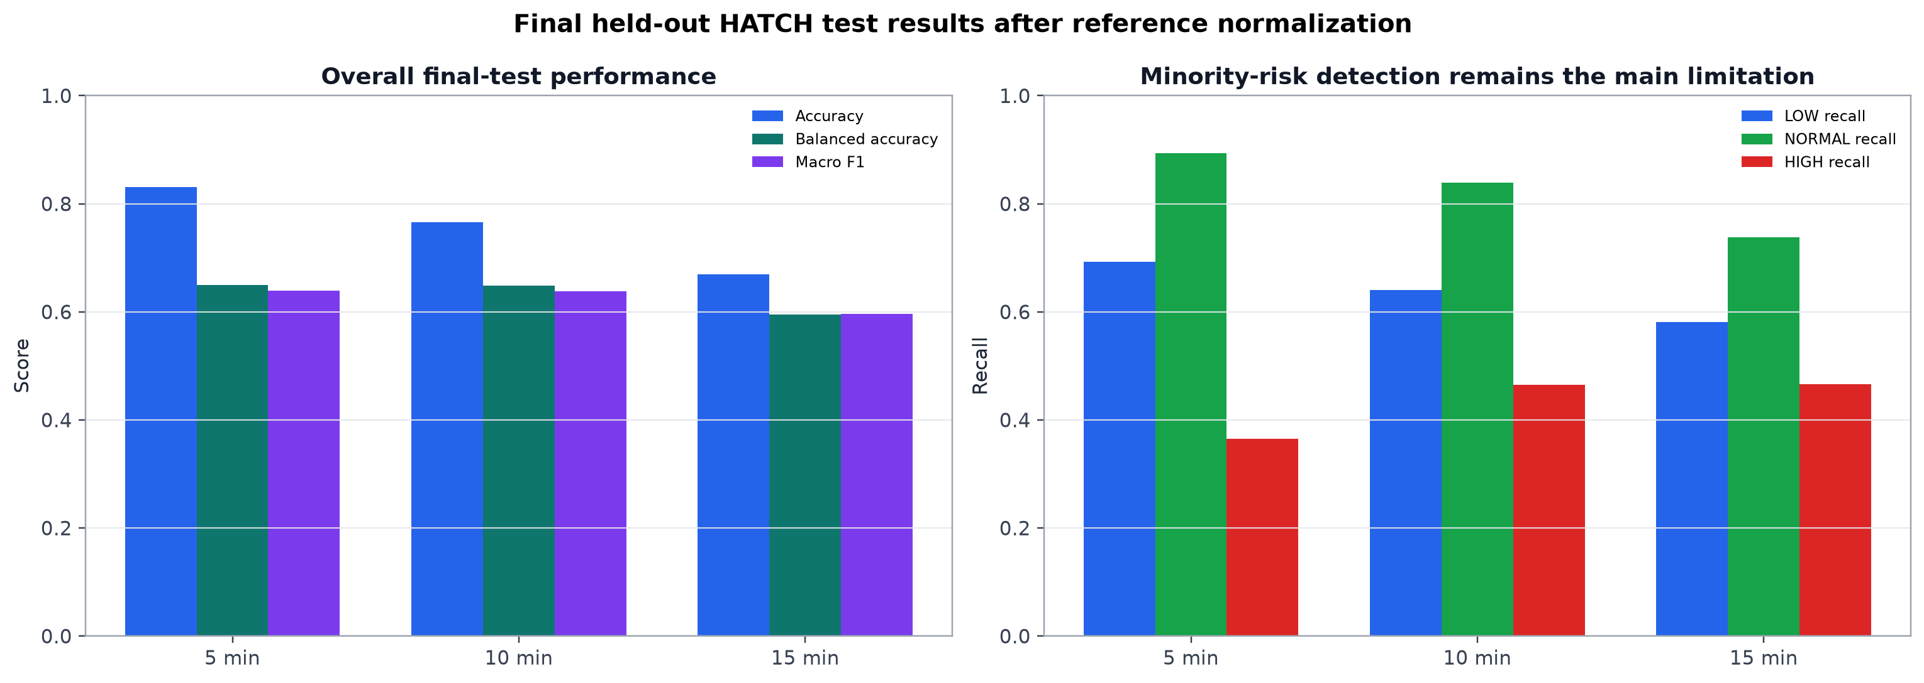
FINAL RESULTS
11
Held-out performance declines with horizon
5 MIN
0.650 BA
Accuracy 0.831 · macro F1 0.639
10 MIN
0.648 BA
Accuracy 0.766 · macro F1 0.639
15 MIN
0.595 BA
Accuracy 0.669 · macro F1 0.596
ML-Based Thermal Risk Prediction
Notes:
The 5 and 10 minute models retain similar balanced accuracy. The 15 minute model is weaker, which is expected as uncertainty accumulates. HIGH-class recall remains moderate and is a key improvement target.
[Sources]
- final_analysis_bundle.zip: final_analysis/plots/11_final_test_performance.png
- final_analysis_bundle.zip: final_analysis/key_metrics.csv

Slide 12
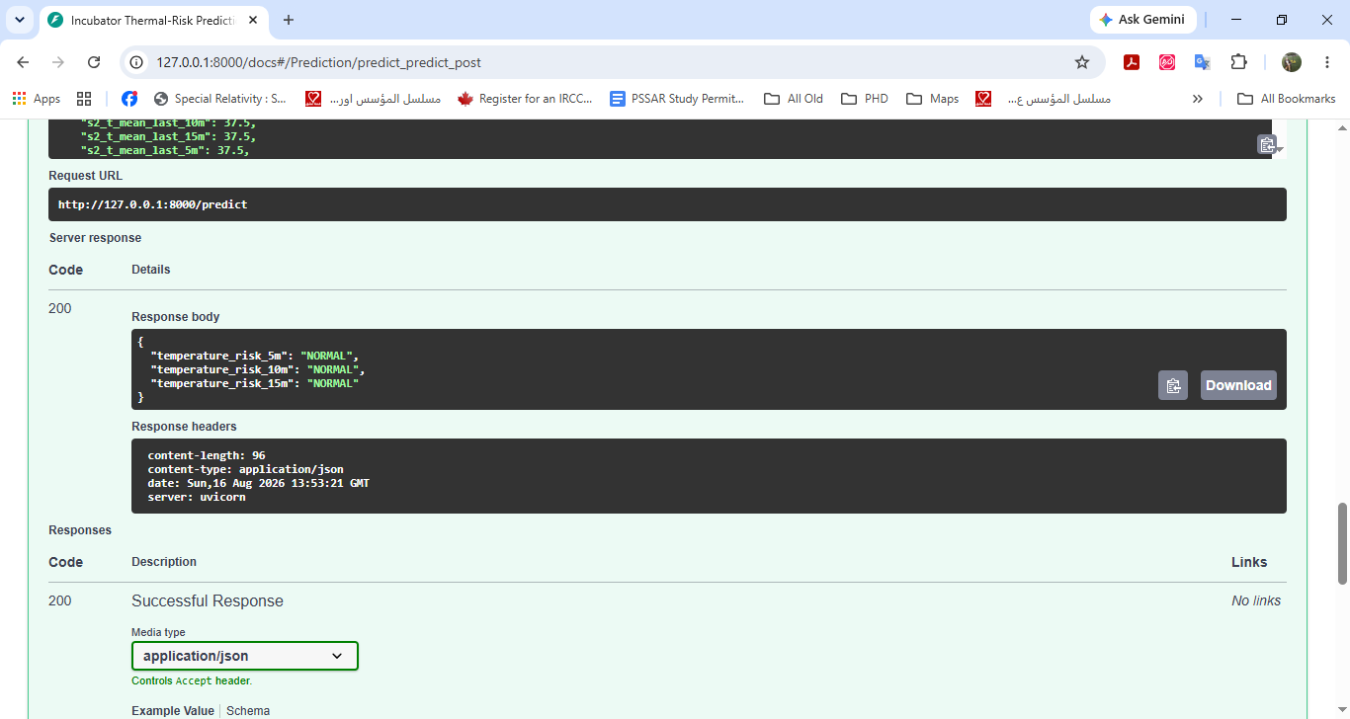
DEPLOYMENT
12
Stage 5 — the models were packaged behind an API
ARTIFACTS
3 full pipelines
Model version 1.0
CONTRACT
31 features
Validated before prediction
ENDPOINTS
/health + /predict
Interactive local Swagger UI
ML-Based Thermal Risk Prediction
Notes:
The API provides a health check and a single prediction request that returns all three horizons. Five held-out examples were used for manual tests.
[Sources]
- Project screenshot: 2026-08-16_16h53_31.png
- final_analysis_bundle.zip: final_analysis/final_analysis_report.md

Slide 13
PROJECT LEARNING
13
Main difficulties and the decisions that resolved them
DIFFICULTY
SOLUTION
Sensor ERR values and missing readings
Use status evidence; retain transparent rejection records
Multiple runs with temporal dependence
Sequence-aware features and chronological split
Imbalanced LOW / NORMAL / HIGH classes
Select with balanced accuracy and macro F1
Mode-dependent HATCH temperature scale
Apply a verified +0.2°C test normalization
ML-Based Thermal Risk Prediction
Notes:
Present these as engineering decisions, not hidden problems. Each difficulty is linked to a concrete method and an auditable output.
[Sources]
- final_analysis_bundle.zip: final_analysis/assumption_evidence.csv
- final_analysis_bundle.zip: final_analysis/final_analysis_report.md

Slide 14
CONCLUSION
14
The capstone is complete and ready to present
The project delivers a reproducible early-warning baseline from validated logs to a working API.
53,061
0.650
3
clean rows
best test BA
deployed models
99.9736% of raw records retained
5 minute Random Forest horizon
One saved pipeline per horizon
Next: collect more incubators and rare events · improve HIGH recall · automate raw-log feature generation · evaluate closed-loop control separately
Thank you
Notes:
Close with the completed scope. Future work should first improve data coverage and minority-class recall. Closed-loop control must be evaluated as a separate engineering and safety project.
[Sources]
- final_analysis_bundle.zip: final_analysis/key_metrics.csv
- final_analysis_bundle.zip: final_analysis/final_analysis_report.md

